Slide 1

ITSE 4931: Operating Systems
Lisanu Tebikew
lisanu@gmail.com
Lecture 5: Threads
March 24, 2015
Slides adopted from Prof. Matt Welsh (Google), http://www.eecs.harvard.edu/~mdw/course/cs161/notes/threads.pdf

Slide 2
Concurrent Programming
Multiprogramming (multitasking): more than one program (thread) can run simultaneously!
E.g. UNIX/Linux, OS/2, Windows NT – 7, Mac OS X!
More efficient than Uniprogramming by allowing multiple programs on one machine
But many programs wants to do many things “at once”
Web browser:
Download web pages, and accept user input simultaneously
Web server:
Handle incoming connections from multiple clients at once
Applications with a Graphical User Interface. E.g. chess
One thread does the displaying the current game on the screen
Another thread responds to user inputs
A third one, figuring out which move to make next
Can't we simply do this with multiple processes?

Slide 3
Recap: Process
(Unix) Process
A(int tmp) {
if (tmp<2)
B();
printf(tmp);
}
B() {
C();
}
C() {
A(2);
}
A(1);
…
Memory
Stack
Resources
I/O State
(e.g., file, socket contexts)
Sequential stream of instructions
CPU state (PC, SP, registers..)
Stored in OS

Slide 4
Concurrent programming with Multiple Processes
Process 1
Process 2
Process N
Mem.
Mem.
Mem.
IO
state
IO
state
…
IO
state
CPU
state
CPU
state
CPU
state
CPU sched.
OS
1 process at a time
CPU
(1 core)

Slide 5
Why processes are not always ideal...
Problems?
Space: Each process has its own PCB and OS resources
e.g., 1.7 KB per task_struct on Linux!
Time: Creating a new process is often very expensive
Processes don't (directly) share memory
Each process has its own address space
Parallel and concurrent programs often want to directly manipulate the same memory
Web browser: Share buffer for HTML page and inlined images
Web server: Share memory cache of recently-accessed pages
Scientific programs: Share memory of data set being processes
Note: Many OS's provide some form of inter-process shared memory
Still, this requires more programmer work and does not address the efficiency issues.

Slide 6
Can we do better?
What can we share across all of these processes?
Same code – generally running the same or similar programs
Same data
Same OS resources (files, sockets, etc.)
What is private to each task?
Execution state: CPU registers, program counter (instruction register), and the execution stack
Why separate stack?
The sequence of functions called differs among the tasks
To solve efficiency problems:
Separate the concept of a process from a thread of control for concurrent programs
The process is the address space and OS resources (can be shared)
Each thread has its own CPU execution state (is kept private)
Process 1
threads
Mem.
…
IO
state
CPU
state
CPU
state

Slide 7
Review: Execution Stack Example
addrX:
A(int tmp) {
if (tmp<2)
B();
printf(tmp);
}
B() {
C();
}
C() {
A(2);
}
A(1);
exit;
.
.
.
addrY:
.
.
.
addrU:
.
.
.
Stack holds function arguments, return address, local variables
Permits recursive execution
Crucial to modern languages
addrV:
.
.
.
addrZ:

Slide 8
Review: Execution Stack Example
A: tmp=1
ret=addrZ
addrX:
A(int tmp) {
if (tmp<2)
B();
printf(tmp);
}
B() {
C();
}
C() {
A(2);
}
A(1);
exit;
Stack
Pointer
.
.
.
Stack Growth
addrY:
.
.
.
addrU:
.
.
.
Stack holds function arguments, return address, local variables
Permits recursive execution
Crucial to modern languages
addrV:
.
.
.
addrZ:

Slide 9
Review: Execution Stack Example
A: tmp=1
ret=addrZ
addrX:
A(int tmp) {
if (tmp<2)
B();
printf(tmp);
}
B() {
C();
}
C() {
A(2);
}
A(1);
exit;
Stack
Pointer
.
.
.
Stack Growth
addrY:
.
.
.
addrU:
.
.
.
Stack holds function arguments, return address, local variables
Permits recursive execution
Crucial to modern languages
addrV:
.
.
.
addrZ:

Slide 10
Review: Execution Stack Example
A: tmp=1
ret=addrZ
addrX:
A(int tmp) {
if (tmp<2)
B();
printf(tmp);
}
B() {
C();
}
C() {
A(2);
}
A(1);
exit;
Stack
Pointer
.
.
.
Stack Growth
addrY:
.
.
.
addrU:
.
.
.
Stack holds function arguments, return address, local variables
Permits recursive execution
Crucial to modern languages
addrV:
.
.
.
addrZ:

Slide 11
Review: Execution Stack Example
A: tmp=1
ret=addrZ
addrX:
A(int tmp) {
if (tmp<2)
B();
printf(tmp);
}
B() {
C();
}
C() {
A(2);
}
A(1);
exit;
.
.
.
B: ret=addrY
Stack
Pointer
addrY:
.
.
.
Stack Growth
addrU:
.
.
.
Stack holds function arguments, return address, local variables
Permits recursive execution
Crucial to modern languages
addrV:
.
.
.
addrZ:

Slide 12
Review: Execution Stack Example
A: tmp=1
ret=addrZ
addrX:
A(int tmp) {
if (tmp<2)
B();
printf(tmp);
}
B() {
C();
}
C() {
A(2);
}
A(1);
exit;
.
.
.
B: ret=addrY
Stack
Pointer
addrY:
.
.
.
Stack Growth
addrU:
.
.
.
Stack holds function arguments, return address, local variables
Permits recursive execution
Crucial to modern languages
addrV:
.
.
.
addrZ:

Slide 13
Review: Execution Stack Example
A: tmp=1
ret=addrZ
addrX:
A(int tmp) {
if (tmp<2)
B();
printf(tmp);
}
B() {
C();
}
C() {
A(2);
}
A(1);
exit;
.
.
.
B: ret=addrY
C: ret=addrU
addrY:
Stack
Pointer
.
.
.
Stack Growth
addrU:
.
.
.
Stack holds function arguments, return address, local variables
Permits recursive execution
Crucial to modern languages
addrV:
.
.
.
addrZ:

Slide 14
Review: Execution Stack Example
A: tmp=1
ret=addrZ
addrX:
A(int tmp) {
if (tmp<2)
B();
printf(tmp);
}
B() {
C();
}
C() {
A(2);
}
A(1);
exit;
.
.
.
B: ret=addrY
C: ret=addrU
addrY:
Stack
Pointer
.
.
.
Stack Growth
addrU:
.
.
.
Stack holds function arguments, return address, local variables
Permits recursive execution
Crucial to modern languages
addrV:
.
.
.
addrZ:

Slide 15
Review: Execution Stack Example
A: tmp=1
ret=addrZ
addrX:
A(int tmp) {
if (tmp<2)
B();
printf(tmp);
}
B() {
C();
}
C() {
A(2);
}
A(1);
exit;
.
.
.
B: ret=addrY
C: ret=addrU
addrY:
.
.
.
A: tmp=2
ret=addrV
Stack
Pointer
addrU:
Stack Growth
.
.
.
Stack holds function arguments, return address, local variables
Permits recursive execution
Crucial to modern languages
addrV:
.
.
.
addrZ:

Slide 16
Review: Execution Stack Example
A: tmp=1
ret=addrZ
addrX:
A(int tmp) {
if (tmp<2)
B();
printf(tmp);
}
B() {
C();
}
C() {
A(2);
}
A(1);
exit;
.
.
.
B: ret=addrY
C: ret=addrU
addrY:
.
.
.
A: tmp=2
ret=addrV
Stack
Pointer
addrU:
Stack Growth
.
.
.
Stack holds function arguments, return address, local variables
Permits recursive execution
Crucial to modern languages
addrV:
.
.
.
addrZ:

Slide 17
Review: Execution Stack Example
A: tmp=1
ret=addrZ
addrX:
A(int tmp) {
if (tmp<2)
B();
printf(tmp);
}
B() {
C();
}
C() {
A(2);
}
A(1);
exit;
.
.
.
B: ret=addrY
C: ret=addrU
addrY:
.
.
.
A: tmp=2
ret=addrV
Stack
Pointer
addrU:
Stack Growth
.
.
.
Output:
2
addrV:
.
.
.
addrZ:

Slide 18
Review: Execution Stack Example
A: tmp=1
ret=addrZ
addrX:
A(int tmp) {
if (tmp<2)
B();
printf(tmp);
}
B() {
C();
}
C() {
A(2);
}
A(1);
exit;
.
.
.
B: ret=addrY
C: ret=addrU
addrY:
Stack
Pointer
.
.
.
Stack Growth
addrU:
.
.
.
Output:
2
addrV:
.
.
.
addrZ:

Slide 19
Review: Execution Stack Example
A: tmp=1
ret=addrZ
addrX:
A(int tmp) {
if (tmp<2)
B();
printf(tmp);
}
B() {
C();
}
C() {
A(2);
}
A(1);
exit;
.
.
.
B: ret=addrY
Stack
Pointer
addrY:
.
.
.
Stack Growth
addrU:
.
.
.
Output:
2
addrV:
.
.
.
addrZ:

Slide 20
Review: Execution Stack Example
A: tmp=1
ret=addrZ
addrX:
A(int tmp) {
if (tmp<2)
B();
printf(tmp);
}
B() {
C();
}
C() {
A(2);
}
A(1);
exit;
.
.
.
Stack
Pointer
Stack Growth
addrY:
.
.
.
addrU:
.
.
.
Output:
2
1
addrV:
.
.
.
addrZ:

Slide 21
Review: Execution Stack Example
addrX:
A(int tmp) {
if (tmp<2)
B();
printf(tmp);
}
B() {
C();
}
C() {
A(2);
}
A(1);
exit;
.
.
.
addrY:
.
.
.
addrU:
.
.
.
Output:
2
1
addrV:
.
.
.
addrZ:

Slide 22
Processes and Threads
Each process has one or more threads “within” it
Each thread has its own stack, CPU registers, etc.
All threads within a process share the same address space and OS resources
Threads share memory, so they can communicate directly!
The thread is now the unit of CPU scheduling
A process is just a “container” for its threads
Each process MUST have at least one thread (starts at main())
Each thread is bound to its containing process
A program with multiple threads is called multithreaded process.
Because threads have some of the properties of processes, they are sometimes called lightweight processes.

Slide 23
(Old) Process Address Space
0xFFFFFFFF
(Reserved for OS)
Stack
Stack pointer
Address Space
Heap
Uninitialized vars
(BSS segment)
Initialized vars
(data segment)
Code
Program counter
0x00000000
(text segment)

Slide 24
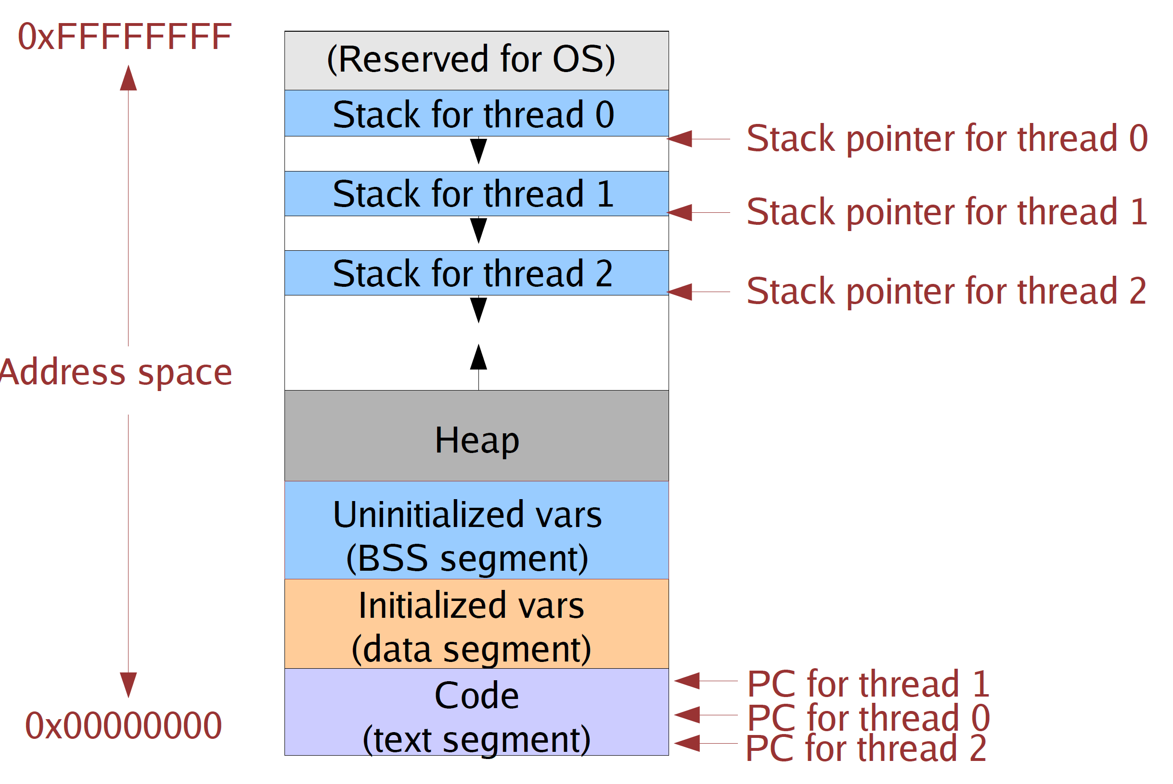
(New) Address Space with Threads
All threads in a single process share the same address space!

Slide 25
Threads Execution: Single Core
Process 1
Process N
threads
threads
Mem.
Mem.
…
IO
state
…
…
IO
state
CPU
state
CPU
state
CPU
state
CPU
state
CPU sched.
OS
1 thread at a time
CPU
(1 core)

Slide 26
Threads Execution: Multi-Cores
Process 1
Process N
threads
threads
Mem.
Mem.
…
IO
state
…
…
IO
state
CPU
state
CPU
state
CPU
state
CPU
state
CPU sched.
OS
4 threads at a time
core 1
Core 2
Core 3
Core 4
CPU

Slide 27
Threads Execution: Hyper-Threading
Process 1
Process N
threads
threads
Mem.
Mem.
…
IO
state
…
…
IO
state
CPU
state
CPU
state
CPU
state
CPU
state
CPU sched.
OS
hardware-threads
(hyperthreading)
8 threads at a time
core 1
core 2
core 3
core 4
CPU

Slide 28
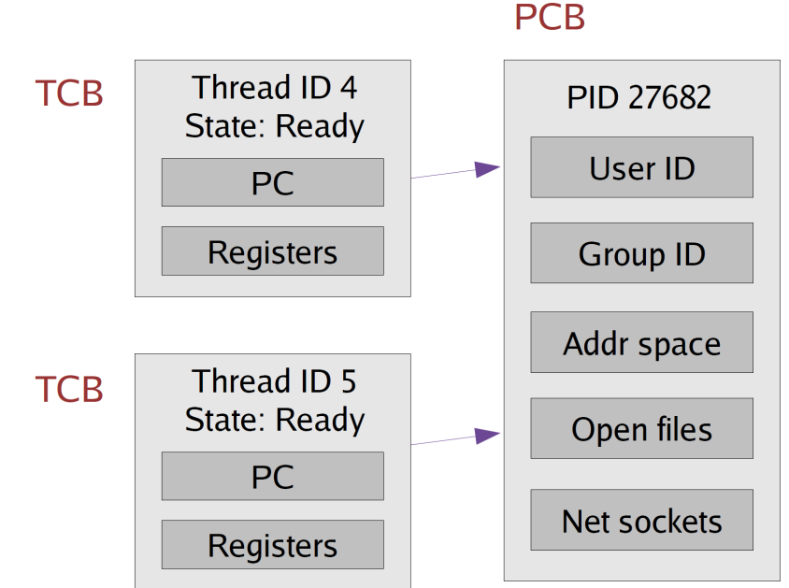
Implementing Threads
Given what we know about processes, implementing threads is “easy”
Idea: Break the PCB into two pieces:
Thread-specific stuff: Processor state
Task Control Block (TCB) A.K.A Thread Table
Process-specific stuff: Address space and OS resources (open files, etc.)
Process Control Block

Slide 29
Thread Control Block (TCB)
TCB contains info on a single thread
Just processor state and pointer to corresponding PCB
PCB contains information on the containing process
Address space and OS resources ... but NO processor state!

Slide 30
Thread Control Block (TCB)
TCB's are smaller and cheaper than processes
Linux TCB (thread_struct) has 24 fields
Linux PCB (task_struct) has 106 fields

Slide 31
Context Switching
TCB is now the unit of a context switch
Ready queue, wait queues, etc. now contain pointers t o TCB's
Context switch causes CPU state to be copied to/from the TCB
Ready
Queue
Head
Other
State
TCB₉
Link
Other
State
TCB₆
Link
Other
State
TCB₁₆
Link
Tail
Registers
Registers
Registers
SSD
Unit 0
Head
Tail
Disk
Unit 0
Head
Other
State
TCB₂
Link
Other
State
TCB₃
Link
Tail
Registers
Registers
Disk
Unit 2
Head
Tail
Other
State
TCB₈
Ether
Netwk 0
Link
Head
Tail
Registers

Slide 32
Context Switching
Context switch between two threads in the same process:
No need to change address space
Context switch between two threads in different processes:
Must change address space
Ready
Queue
Head
Other
State
TCB₉
Link
Other
State
TCB₆
Link
Other
State
TCB₁₆
Link
Tail
Registers
Registers
Registers
SSD
Unit 0
Head
Tail
Disk
Unit 0
Head
Other
State
TCB₂
Link
Other
State
TCB₃
Link
Tail
Registers
Registers
Disk
Unit 2
Head
Tail
Other
State
TCB₈
Ether
Netwk 0
Link
Head
Tail
Registers

Slide 33
Implementing Threads
Where to support threads
Kernel threads
Threads directly supported by the kernel
Most modern OS support kernel threads
User-Level threads
Thread management done by user-­level threads library
Kernel knows nothing
Most modern Oss have libraries to manage threads

Slide 34
Kernel-level threads
OS knows about and manages all the threads in a process
All thread operations are implemented in the kernel
The OS schedules all of the threads in the system
Called kernel-level threads
Program makes a system call to create or destroy thread.
Pro: Can assign different scheduling priorities to each one
Can assign different scheduling priorities to each one
Kernel can context switch between multiple threads in one process
Con: Thread operations require calling the kernel
Creating, destroying, or context switching require system calls
Trapping to make a system call is very slow!!

Slide 35
User-Level Threads
Early UNIX designs did not support threads at the kernel level
OS only knew about processes with separate address spaces
However, can still implement threads as a user-level library
A.K.A a thread library
A thread library provides the programmer an API for creating and managing threads
Just like libc library provides with APIs in stdio.h, stdlib.h, string.h,…
OS does not need to know anything about multiple threads in a process!
How is this possible?
Recall: All threads in a process share the same address space.
So, managing multiple threads only requires switching the CPU state (PC, registers, etc.)
And this can be done directly by a user program without OS help!

Slide 36
Implementing User-Level Threads
Implement all thread functions as a user-level library
E.g In UNIX/Linux the pthread library found in libphread.a
OS thinks the process has a single thread (the thread that starts at main)
Use the same PCB structure as in the last lecture
OS need not know anything about multiple threads in a process!
How to create a user-level thread?
Thread library maintains a TCB (Thread Control Block a.k.aThread Table) for each thread in the application
Just a linked list of TCBs
typedef struct tcb {
unsigned long esp;/*Stack pointer of thread*/
char *t_stack; /*Bottom of thread’s stack*/
/* ... */
};
Allocate a separate stack for each thread (usually with malloc)

Slide 37
User-level thread address space
Stacks must be allocated carefully and managed by the thread library.
(Kernel Stack)
Original stack
(provided by OS)
Stack (for thread #1)
Stack pointer for thread #1
Additional thread
stacks allocated
Stack (for thread #2)
Stack pointer for thread #2
by process
Heap
Uninitialized vars
(
BSS segment
)
Initialized vars
(
data segment
)
Code
PC for thread #1
(
text segment
PC for thread #2
)

Slide 38
User-level Context Switching
How to switch between user-level threads?
Machine-dependent thread-switch function
Need some way to swap CPU state.
See next slide for 32 bit intel context switch
Fortunately, this does not require any privileged instructions!
So, the threads library can use the same instructions as the OS to save or load the CPU state into the TCB.

Slide 39
x86 thread_switch
pushl %ebp; movl %esp,%ebp # Save frame pointer
pushl %ebx; pushl %esi;pushl %edi #Save callee-saved regs
movl 8(%ebp),%edx # %edx = thread_current
movl 12(%ebp),%eax # %eax = thread_next
movl %esp,(%edx) # %edx->esp = %esp
movl (%eax),%esp # %esp = %eax->esp
popl %edi; popl %esi;popl %ebx #Restore callee-saved regs
popl %ebp # Restore frame pointer
ret # Resume execution
This is literally switch code from simple thread lib
void thread_switch(tcb * current, tcb* next);
Nothing magic happens here
C library functions setjmp() and longjmp can also be used

Slide 40
Preemptive vs. nonpreemptive threads
How to prevent a single user-level thread from hogging the CPU?
Strategy 1: Require threads to cooperate
Called non-preemptive threads
Each thread must call back into the thread library periodically
This gives the thread library control over the thread's execution
yield() operation:
Thread voluntarily “gives up” the CPU
Strategy 2: Use preemption
Thread library tells OS to send it a signal periodically
A signal is like a hardware interrupt
Causes the process to jump into a signal handler
The signal handler gives control back to the thread library
Thread library then context switches to a new thread

Slide 41
User-level threads
Pro: Thread operations are very fast
Typically 10-100x faster than going through the kernel
Pro: Thread state is very small
Just CPU state and stack, no additional overhead
Con: If one thread blocks, it stalls the entire process
e.g., If one thread waits for file I/O, Since kernel is unaware of thread structure, all threads in process have to wait
Con: Can't use multiple CPUs!
Kernel only knows about one CPU context

Slide 42
User Level thread Example
Pthreads refers to the POSIX standard defining an API for thread creation and synchronization.
Linux / Unix systems implement this
Win32 API also defines similar thread management library
For Windows based systems

Slide 43
Pthreads User level thread library
Standard API called POSIX threads
int pthread_create(pthread_t * thread,
pthread_attr_t * attr, void *(*start_routine)(void *), void * arg);
thread: Returns a pointer to the new TCB
attr: Set of attributes for the new thread
Scheduling policy, etc.
start_routine: Function pointer to “main function” for new thread
arg: Argument to start_routine()
void pthread_exit(void *retval);
Exit with the given return value
int pthread_join(pthread_t thread, void **thread_return);
Waits for “thread” to exit, returns return val of the thread

Slide 44
Administrative Stuff
Reading for this lecture
Required: Tanenbaum, Modern Operating Systems 4th Ed. Section 2.2
Next Lecture: Case Study: Linux process and thread implementation
How are processes and threads implemented on the Linux kernel
Play around with task_struct, process_struct, and various queues
Can get pretty technical, so I suggest that you read ahead
Reading: Linux kernel development 3rd Ed. Chapter 3
We will cover pthreads library in our laboratory session.
https://computing.llnl.gov/tutorials/pthreads/

